Slide 1
SADI vs OAGB
Marco Adamo
University college london hospital

Slide 2
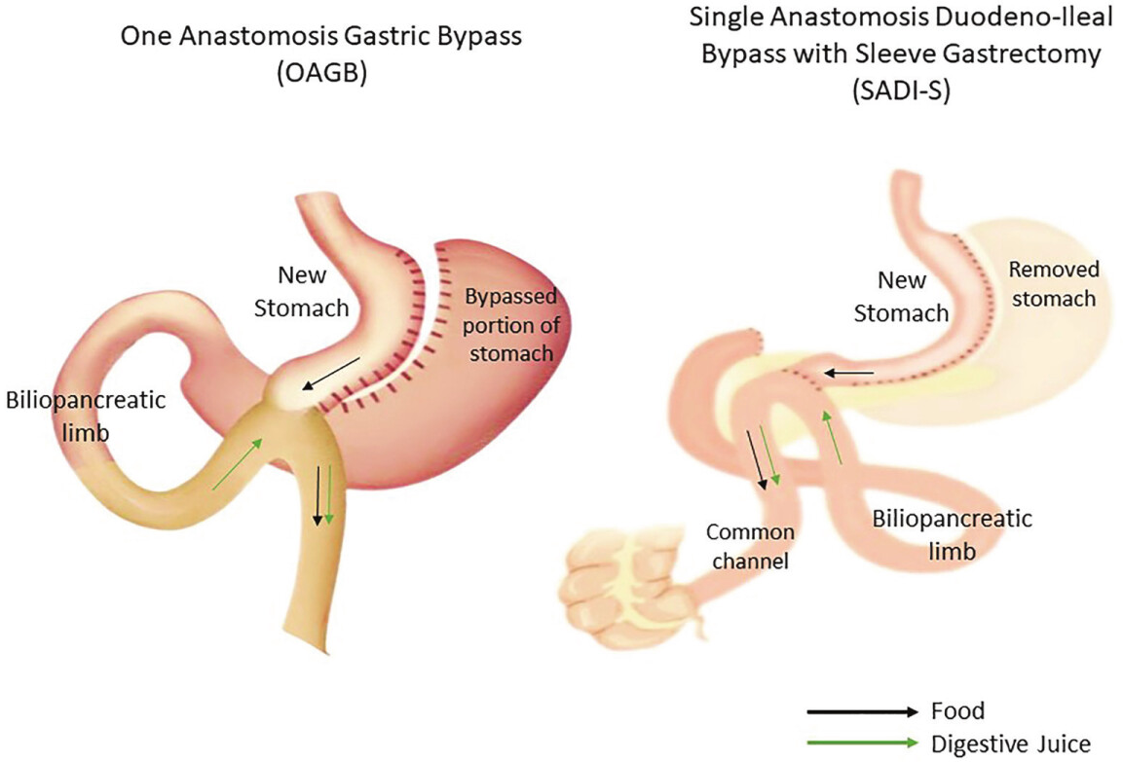
Which one is a better option?

Slide 3


Slide 4
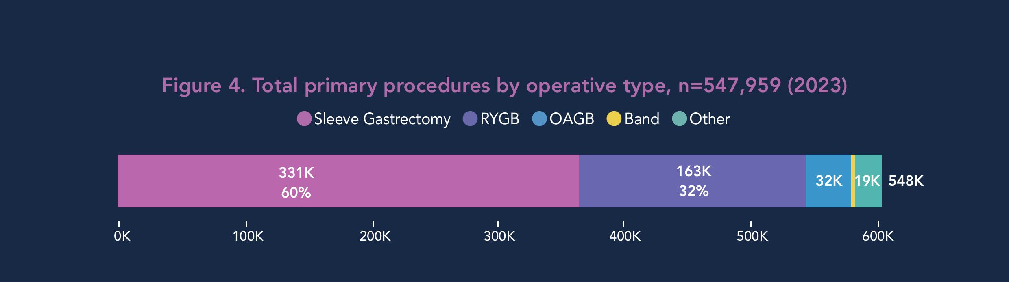
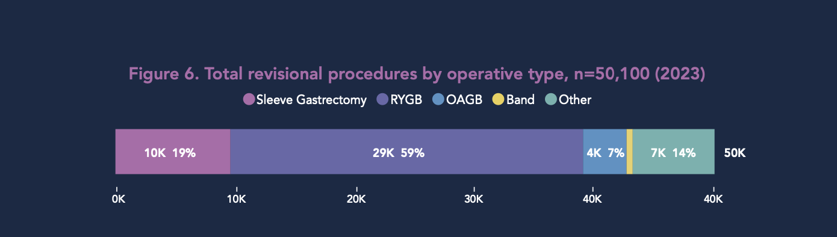
9TH IFSO GLOBAL REGISTRY REPORT 2024

Slide 5
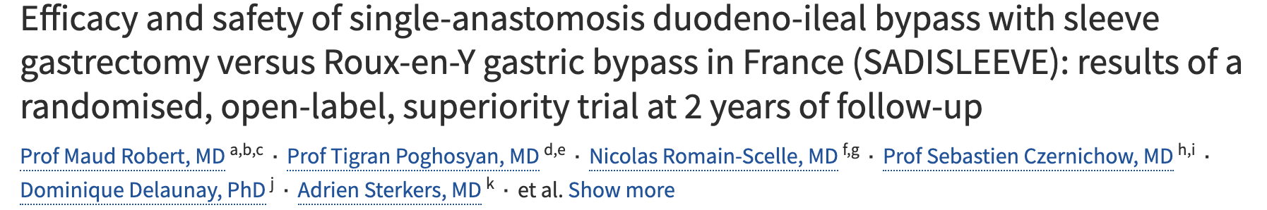
 | Mean %EWL at 2 years
SADI - S | 76%
RYGB | 68.1%
 | Total procedure related serious adverse events |  | SAEs
SADI - S | 40 |  | Severe diarrhoea (8) Anastomotic leak (3)
RYGB | 35 |  | Internal hernia (5)
The mean %EWL for SADI-S was statistically significantly higher than for RYGB (p=0.026).
Overall comparable safety profile

Slide 6
Comparative studies
SADI-S vs OAGB ?

Slide 7
Comparative studies
Study | Type | SADI-S Vs OAGB | F-up | %TWL SADI-S vs OAGB | Deficiencies / complications | Key outcomes & notes
Salama et al. 2023 | Retrospective, revisional post-LSG, single centre | 42 : 49 | ≥ 5 yrs | 30 ± 18% vs 19 ± 16 % (p < 0.05) | SADI-S: transient steatorrhea (14%), ↓vit D & iron in 10–12%; OAGB: mild iron/B12 deficiency (~8%), bile reflux (6%) | SADI-S had greater sustained WL & comorbidity remission; OAGB had more reflux-related issues
Bashah et al. 2020 | Retrospective, revisional after LSG | 42 : 49 | 18 m | 26 ± 7 % vs 21 ± 11 % | Mild deficiencies in both groups; no severe malnutrition; transient diarrhoea more frequent with SADI-S. | Short-term SADI-S achieved higher WL; similar T2D remission; fewer upper-GI complaints vs OAGB.
El-Shayeb et al. 2023 | Prospective comparative, revisional | 25 : 25 | 2 yrs | 27 % vs 25 % | Both: Iron (10–12%), B12 (8–10%), vit D (10%); no severe hypoalbuminemia. | Comparable WL & metabolic outcomes; operative time longer for SADI-S; no mortality.
Gallucci et al. 2024 | Multicentre observational (revisional after SG) | — | 2 yrs | 30 % vs 25 % | Nutritional issues not major; transient diarrhoea/steatorrhea slightly more with SADI-S; reflux higher in OAGB. | Both effective; OAGB had higher mid-term complication/conversion rate.
Balamurugan et al. 2023 | Systematic review & comparisons | pooled | var. | Pooled mean %TWL ≈ 30–33 % SADI-S vs 25–28 % OAGB | Nutritional deficiency rates pooled: SADI-S ≈ 15–25 % vs OAGB ≈ 10–15 %. | SADI-S → higher WL/diabetes remission; OAGB → lower bile reflux risk, fewer deficiencies.
Yusuf et al. 2024 | Systematic review + meta-analysis | pooled | 1–3 yrs | Similar pattern (SADI ~ 30–32 %; OAGB ~ 25–27 %) | Consensus: SADI-S → higher risk for fat-soluble vit deficiency & protein malnutrition (rare < 2%); OAGB → higher bile reflux/marginal ulcer. | Consensus summary: both effective; choose based on GERD risk vs nutritional reserve.

Slide 8
Reported Outcomes
 | SADI-S | OAGB
%TWL (2–5 yrs) | 28–32 % | 22–26 %
TD2M remission (mid-term) | 70–85 % | 60–75 %
Nutritional deficiency | 15–25 % (vit D, iron, B12) | 8–15 % (iron,B12)
Reflux/marginal ulcer | < 5 % | 5–15 %
Protein malnutrition | 0–3 % | < 1 %
Conversion/revision rate (mid-term) | Low (~2–5 %) | Higher (~8–12 %, often reflux-related)

Slide 9
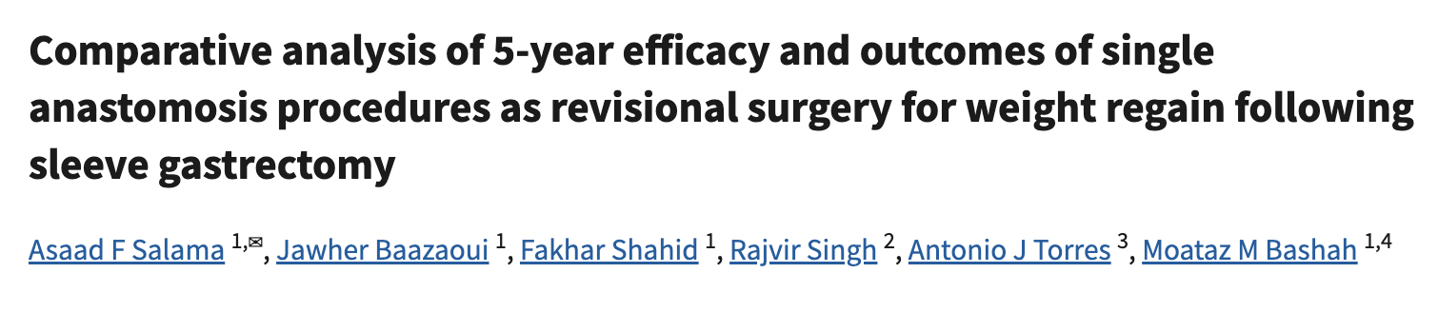
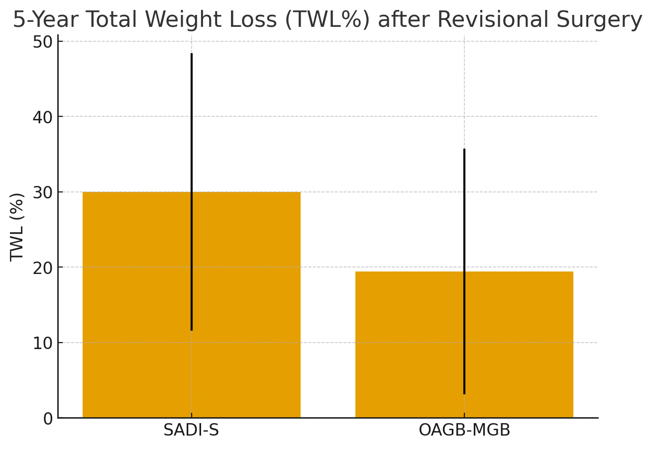
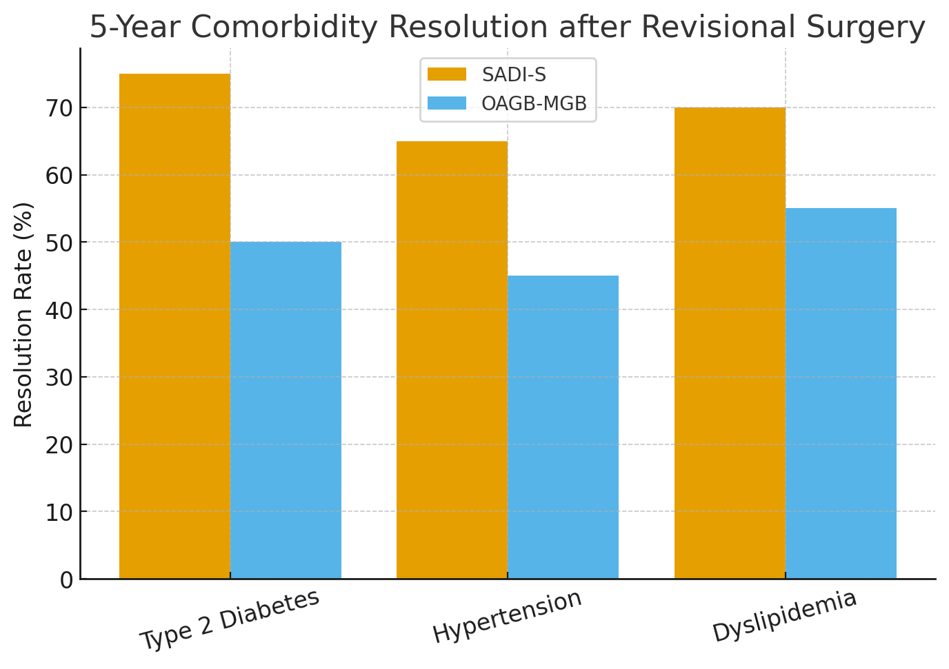

Slide 10
Key Points
 | SADI-S | OAGB
Anatomy | Sleeve + Single anastomosis duodenum and ileum | Long gastric pouch sleeve-like, with single gastro-ileal anastomosis
Pylorus | Preserved | Bypassed
Afferent limb | Not measured | 150-200cms
Common Channel | 250-300cm | Not measured
Risk of dumping | Lower | Higher
Technical aspect | Challenging | Simpler technique
Malabsorption | Has a malabsorbitive component | Has a malabsorbitive component
Bile Reflux | Rare | Reported
Anastomotic Ulcer | Lower risks of marginal ulcers | Higher risk of marginal ulcers
Deficiencies | Reported | Reported

Slide 11
Limitations
There are no randomized controlled trials (yet) directly comparing SADI-S vs OAGB
Comparative studies are retrospective
Outcomes depend heavily on surgical technique, limbs length, center volume, follow-up rate and protocols

Slide 12
Considerations
SADI-S is a more anatomical procedure with theoretical physiological advantage and suits more a two-stage approach
OAGB is an attractive primary option and can be a pragmatical revisional approach
Consensus should be reached on limbs length (afferent/efferent/common channel) for better standardisation
Both procedures have shown excellent outcomes and limited short- and long- term morbidity

Slide 13
Questions
Which procedure offers superior weight loss, metabolic control, hormonal vs malabsorptive?
Is the effort of preserving the pylorus reflected in better outcomes?

Slide 14
Which one is a better option?

Slide 15

Thank you

Slide 16
References
Salama AF, Baazaoui J, Shahid F, Singh R, Torres AJ, Bashah MM. Comparative analysis of 5-year efficacy and outcomes of single anastomosis procedures as revisional surgery for weight regain following sleeve gastrectomy. Surg Endosc. 2023 Oct;37(10):7548-7555. doi: 10.1007/s00464-023-10234-3. Epub 2023 Jul 11. PMID: 37432485; PMCID: PMC10520093.
Bashah M, Aleter A, Baazaoui J, El-Menyar A, Torres A, Salama A. Single Anastomosis Duodeno-ileostomy (SADI-S) Versus One Anastomosis Gastric Bypass (OAGB-MGB) as Revisional Procedures for Patients with Weight Recidivism After Sleeve Gastrectomy: a Comparative Analysis of Efficacy and Outcomes. Obes Surg. 2020 Dec;30(12):4715-4723. doi: 10.1007/s11695-020-04933-2. Epub 2020 Aug 26. PMID: 32845477; PMCID: PMC7719107.
Shayeb, Basem & Sabry, Alaa & Marzouk, Mohamed & Sabry, Amr & Ahmed, Dina. (2023). Laparoscopic SADI-S versus OAGB as Revisional Procedures after Failed Sleeve Gastrectomy; Comparative Study after 2 Years of Follow up. Ain Shams Journal of Surgery. 16. 261-272. 10.21608/asjs.2023.309455.
Gallucci, P., Marincola, G., Pennestrì, F. et al. One-Anastomosis Gastric Bypass (OABG) vs. Single Anastomosis Duodeno-Ileal Bypass (SADI) as revisional procedure following Sleeve Gastrectomy: results of a multicenter study. Langenbecks Arch Surg 409, 128 (2024)
Balamurugan G, Leo SJ, Sivagnanam ST, Balaji Prasad S, Ravindra C, Rengan V, Arora E, Bindal V. Comparison of Efficacy and Safety Between Roux-en-Y Gastric Bypass (RYGB) vs One Anastomosis Gastric Bypass (OAGB) vs Single Anastomosis Duodeno-ileal Bypass with Sleeve Gastrectomy (SADI-S): a Systematic Review of Bariatric and Metabolic Surgery. Obes Surg. 2023 Jul;33(7):2194-2209. doi: 10.1007/s11695-023-06602-6. Epub 2023 May 4. PMID: 37140720
Ahmed, Yusuf & Ataya Frcs, Karim & Almubarak, Isa & Ali, Manar & Almubarak, Abdulla & Yusuf, Walaa & Simeonovski, Stefan & Mahran, Mostafa & Aljaafreh, Almoutuz & El Bourji, Hussein & Yang, Wah. (2024). Laparoscopic Single Anastomosis Duodeno-ileal Bypass versus One Anastomosis Gastric Bypass as Revisional Procedures after Sleeve Gastrectomy: Meta-analysis and Systematic Review. 10.21203/rs.3.rs-4850487/v1.

